Slide 1
Soar Command Line Interface
Soar 8.6
Jonathan Voigt
University of Michigan
Soar Workshop 25

Slide 2
Problems with 8.5’s Command Line
Soar 8.5’s command line syntax
  Sometimes undefined
  Occasionally inconsistent
  Difficult for new users
Tcl legacy
  Although the Soar C interface is independent of Tcl, the same is not true for all of the commands
    Some commands implemented in the TSI or wrapped by the TSI for full functionality
    Some “Soar” commands are Tcl commands
      source
Order of options & arguments
  Often important when it could be irrelevant
Client-side implementation

Slide 3
A Solution: The Soar 8.6 Command Line Interface (CLI) Module
Managed by KernelSML (server-side)
Communicates with kernel using gSKI
  EvilBackDoor (EBD) used for required features incomplete or unimplemented in gSKI
Implements a revised command syntax
…
KernelSML
gSKI
Soar
Kernel
CLI
EBD

Slide 4
Soar 8.6 CLI Syntax Goals
Consistency
  Use the same syntax patterns across the space of commands
  Easy to learn
Flexibility
  Many different ways to do the same thing
Legacy
  Familiarity to existing Soar users

Slide 5
Syntax Changes
New syntax based on GNU GetOpt
  Part of GNU C library
    http://www.gnu.org/software/libc/manual/html_node/Getopt.html
Widely used for command line option and argument processing
Open source strikes back: GetOpt code taken and modified for use in Soar 8.6 CLI

Slide 6
Soar 8.6 Arguments
Argument: An element of the command line separated by white space
Command name: The first argument
White space inside quotes, braces and parenthesis ignored
4 arguments:
watch -l 2 –r
2 arguments:
sp {hello-world
(state <s> ^type state)
-->
(write |Hello World|)
(halt)
}

Slide 7
Soar 8.6 Options
Short options: Arguments prefixed by a single dash
Short options may be combined with one dash
Long options: Arguments prefixed by two dashes
-c, -O, -cPp
Three options!
--chunks, --disable

Slide 8
Soar 8.6 Option Arguments
Option argument: An argument immediately following an option that takes an argument
Option arguments may be optional
  Optional option arguments cannot start with a dash!
4 is the option argument:
watch --level 4
“removes” is the option argument
watch-wmes --add-filter -t removes S3 * *

Slide 9
The Life of a Command Line
CLI
DoCommandLine()
Tokenize()
DoCommandInternal()
ParseX()
DoX()
App
KernelSML

Slide 10
DoCommandLine()
Called from KernelSML
  Part of the exposed interface
Handles logging
  Top-level
  Command line is ‘pure’
Handles communication with KernelSML
  Marshals XML command result

Slide 11
Tokenize()
First stage of parsing
Splits command line into a vector of arguments
  Splits using spaces, preserving spaces between braces, parenthesis and quotes
Removes comments
  Pound sign (#) comments often found inside Soar files

Slide 12
Tokenize Algorithm
Trim white space and comments from command line
Loop until break or error:
  Remove leading white space
  If command line is empty, break
  Increment argument count
  Save everything up to next white space or the end of the line into argument
    Ignore white space between quotes, brackets, and parenthesis, check for unmatched characters
    Remove characters from command line as they are added to argument
  Store the argument in to a vector of strings

Slide 13
DoCommandInternal()
Help
  Looks for help options on the line
  Calls help command if found
Aliases
  If command name is an alias, substitutions are performed on the argument vector
Partial matches
  If command name is not an alias, it is checked against all commands to see if there is a match
  Substitutes matched command name if found
watch –help
excise -h
x -a excise –a
d run –d 1
exci excise

Slide 14
ParseX()
Parsing separated from processing
  Easier to maintain
Parses the data required to process the command out of the argument vector
  Options and option arguments in all commands parsed out using GetOpt
  Remaining arguments dealt with according to command syntax
All ParseX() function signatures are the same
ParseWatch(gSKI::IAgent* pAgent, std::vector<std::string>& argv)

Slide 15
Option Ordering
No processing is done until command is parsed
  An exception: add-wme (WME parsed by EvilBackDoor)
Options can be in any order
  Options processed left to right
  If options conflict, the last option wins
watch –r –l 2 …preferences turned on, then off by –l 2
watch –l 2 –r …intended behavior (level 2 with preferences)

Slide 16
DoX()
Does the actual processing required to execute the command
Most DoX() function signatures are different
  Depends on the data required to execute the command
DoWatch(gSKI::IAgent* pAgent, const WatchBitset& options,
const WatchBitset& settings, const int wmeSetting,
const int learnSetting)

Slide 17
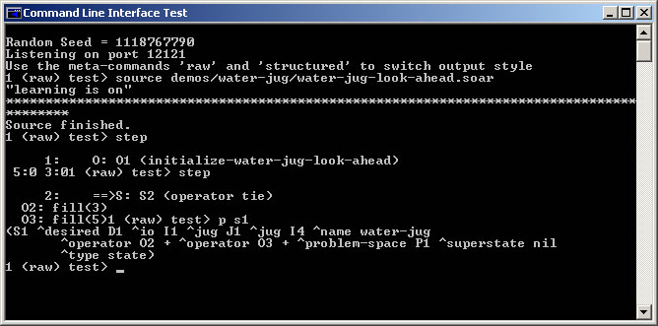
Command Line Interface Test App
Included with Soar 8.6 is a simple CLI module test application
Easy to debug simple changes to the command line interface inside Visual Studio using this app

Slide 18
Nuggets
Coals
Syntax consistency
  Standard option parsing
Simple maintenance
  Parsing separated from processing
  Well documented
Flexible option ordering
  Last option wins
Same command interface for all clients
Many syntax changes
  Bad for existing users
EvilBackDoor and old interface usage
Some command output generated by kernel
  via print callbacks
Structured (XML) output incomplete

Slide 19
Questions?
Online resources:
  voigtjr@gmail.com
  soar-group@lists.sourceforge.net
  http://sitemaker.umich.edu/soar
  http://winter.eecs.umich.edu/soarwiki

